Slide 1
Fertility Nutrition
Clare Blake N.D.
Fertility Massage Therapy & Training

Slide 2
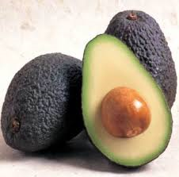
Nutrition & Fertility
Why is nutrition so important
For Fertility?

Slide 3
Nutrition Overview
Macro Nutrients:
Fat, Protein & Carbohydrates
Micro Nutrients:
Minerals, Vitamins & Anti-Oxidants

Slide 4
Protein Overview
Protein is the building block of all cells, enzymes
and formation of hormones.
Protein & Fertility
“Building” a baby
Strong formation of egg and sperm cells
Regulating menstrual cycles
Energy production
Weight regulation
Strong immunity

Slide 5
What are examples of Proteins?

Slide 6
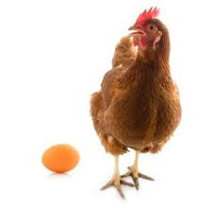
How much protein do we need?
An average female needs approximately 60g of protein
i.e. Average chicken breast
approx 15 – 20g
1 * large egg = 6g

Slide 7
Vegetarian & Protein
Vegetarians can find it harder to reach the required amount of quality protein per day, hence it is important that they are aware of combining their foods correctly to meet their requirements.

Slide 8
Fat Overview
Fats are essential for cellular integrity and
formation of hormones,
Good Fats & Fertility
Balances hormones, regulating menstrual cycles
Stable and strong cells, improving egg & sperm health
Balances inflammation, therefore immunity
Good source of energy
Healthier baby

Slide 9
Good v’s Bad Fats
GOOD
Omega 3 – Anti-inflammatory
vs
BAD
Omega 6 – Inflammatory
Ratio of 6’s : 3’s
Western Ratio 20:1
Ideal Ratio 4:1 (1:1 is optimal)

Slide 10
What are examples of Fats?
Can you put them in categories of Saturated, Monounsaturated & Polyunsaturated?
Or
Omega 3’s, 6’s or 9’s?

Slide 11
Good Fats
Saturated
Organic meats/poultry, Butter
Unpasteurised milk/cheese
Coconut Oil/Cream/Milk
Ghee
Monounsaturated
Olive Oil (for cold use only)
Avocado
Many nuts
Polyunsaturated
(Essential Fatty Acids)
Cod liver/Fish/ Krill Oil (Omega 3–animal based)
Linseed/Flax Oil (Omega 3– vegetable based)
Omega 6 oils found naturally in whole foods

Slide 12
Bad Fats
Trans, Hydrogenated & Highly Inflammatory Fats
Found in most processed foods i.e.
Non-organic meats/poultry & dairy products
Processed meats i.e. salami, ham, deli meats
Margarine
Vegetable Oils
Biscuits, Cakes, Cookies
Packaged foods
Take-aways
Salad dressings
Fried goods
Savoury snacks i.e. crisps
Sweets & chocolates

Slide 13
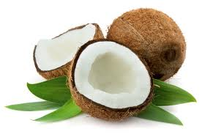
The Wonder Fat!!
Coconuts!
Anti-viral, anti-fungal, anti-microbial
Medium-chain Fatty acid (MCFA)
Lauric Acid – breastmilk
Nutrient absorption
Aid digestive function
Helps regulate blood
sugar levels

Slide 14
Carbohydrate Overview
All carbohydrates break down to sugar
High sugar foods such as grains, processed foods etc... are highly inflammatory
We do not need to eat carbohydrates for “glucose” – our bodies can convert protein & fats to make glucose.
Fructose (fruit sugar) has detrimental effect on liver

Slide 15
Key foods to Avoid or Limit
Low fat or diet products including Skimmed and Semi Skimmed Milk
Processed foods or anything that isn’t “whole” or from “nature”
Sweeteners especially Aspartame
Additives, in particular E621 = MSG
Sugar in any form including Alcohol, Grains, Cereals...

Slide 16
Nutrition for Fertility
What can you do to
help your client?

Slide 17
Colour Coded Food Diary
High inflammatory foods in PINK/RED
Protein in GREEN
Nutrient Rich Foods in BLUE
GOOD Fats in YELLOW

Slide 18
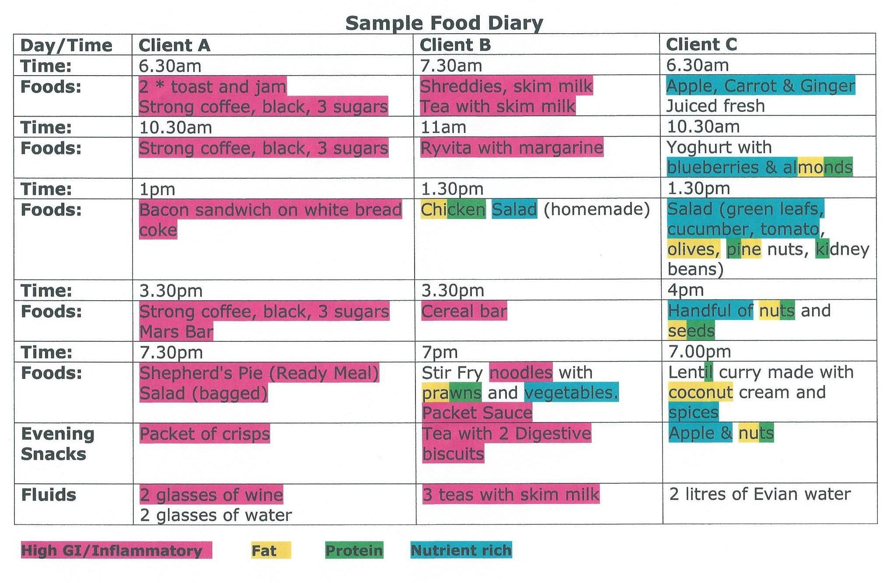
Food Diary

Slide 19
Supplements
Unless you are qualified, you cannot prescribe supplements. However you can point them in the right direction to read up for themselves.
Key Supplements (other than the “pregnancy focused ones) are:
Vitamin D3
Probiotics
Fish/Krill Oil (Omega 3)

Slide 20
Supplements
Avoid: Pregnacare & Well-Woman, anything purchased from the High St.
Synthetic
Additional ingredients detrimental to health
Low dose
Not Bio-available

Slide 21
Remember...
Unless you hold a qualification in Nutrition, it is out of your scope of practise to “prescribe” nutrition – however, you can use a food diary to demonstrate their diets may be lacking in certain macro-nutrients and too high in sugar/inflammatory foods.
They should seek personal nutritional advice from a qualified Nutritionist.

