Slide 1
Mucus & Menstruation
Clare Blake N.D.
Fertility Massage Therapy & Training

Slide 2
Menstrual Cycle
4 Stages of Cycle
Menses
Follicular Phase
Ovulation
Luteal Phase

Slide 3
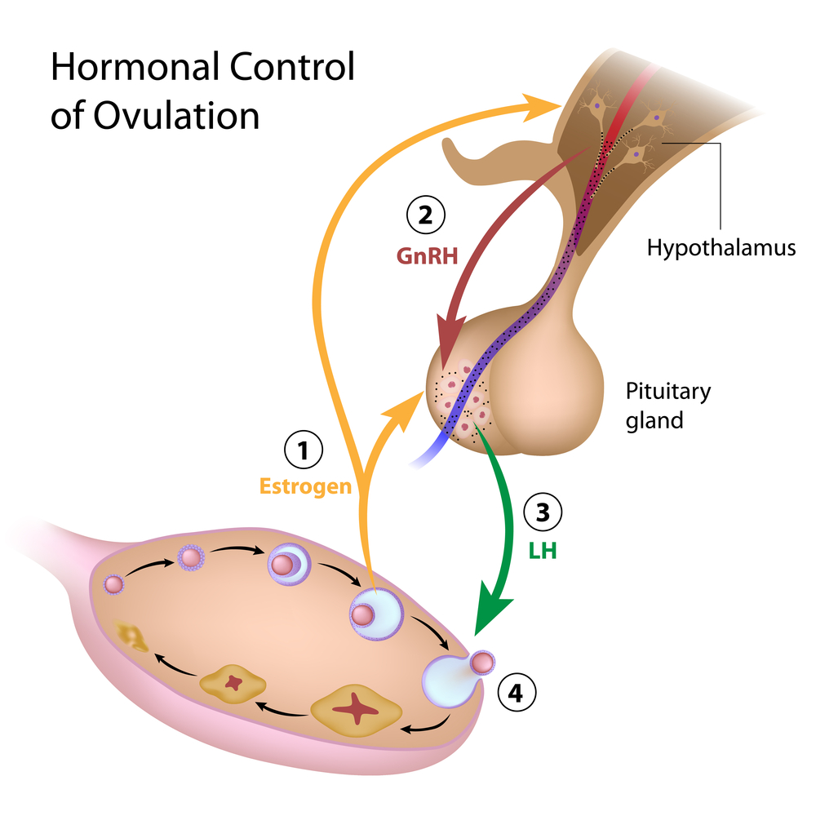
Hormones in Cycle
Ovaries Produce: Oestrogen & Progesterone
Pituitary Produce: FSH & LH
(Follicle Stimulating Hormone & Lutenising Hormone)

Slide 4
Key Hormones in the Menstrual Cycle
GnRH: produced in hypothalamus. Stimulates pituitary to produce FSH & LH
Oestrogen: a proliferator; produced by the follicles that develop within the ovaries from menstruation to ovulation
Progesterone: the heat-producing hormone manufactured by the corpus luteum, immediately following ovulation. Keeps endometrial wall nourished and in place
FSH: produced by the pituitary. Responsible for a dozen or so follicles to become partially matured and the eggs within to approach the capacity to be ovulated
LH: produced by the pituitary. Responsible for both stimulating and completing follicular growth and development of corpus luteum
HCG: ONLY PRODUCED IN PREGNANCY. Once egg has implanted into the uterine wall it releases this pregnancy hormone. This signals the corpus luteum to remain alive

Slide 5
Hormones during Menstrual Cycle

Slide 6
Menstrual Facts
Menses last approx 4-6 days
Follicular phase changes in length, altered easily by stress.
Ovulation usually occurs 2 weeks prior to menstruation, do not ovulate each month
Luteal Phase lasts between 11-16 days approx. If shorter, will not sustain pregnancy.
Excess Oestrogen causes longer cycles
Deficient Progesterone causes shorter cycles

Slide 7
More facts...
At birth every girl is born with around 2million eggs in her ovaries
Only 300-400 will mature during her lifetime
The average age of menarche (period) is between 12-14yrs, but as young as 10 and as late as 16 is normal
A female orgasm has the effect of helping to draw semen up into the uterus and fallopian tubes
At puberty, the hormones Follicle-Stimulating Hormone (FSH) and Luteinizing Hormone (LH) stimulate the production of oestrogen and progesterone. This leads to the developments such as breast tissue, pubic and underarm hair & body fat.
You need at least 17% body fat for this to happen

Slide 8
OCP Oral Contraceptive Pill
OCP affects the cervical crypts that produce mucus
OCP causes excessive development of G cells in the lower cervix, the crypts producing them being deeper and the bulging "grapes" larger. (1)
OCP inhibits mineral uptake particularly B6, B12, B9 (folic acid), B2, B1. Also Magnesium, Zinc & Vitamin C
Something that is not made public is the fact that in order for the liver to metabolize birth control pills, it requires extra B-complex vitamins, vitamin C, magnesium and zinc. Women who have been taking birth control pills for a long time often become deficient in nutrients. (2)
regina@rightsofpassagemidwifery.com

Slide 9
OCP Oral Contraceptive Pill
Lutenising Hormone doesn’t fully develop until 20 years old.
OCP usage before age of 20 will cause immature LH. This in turn affects Luteal Phase & Progesterone

Slide 10
OCP Affect on Baby
Healthy foetal development is impaired.
Limb defects
Increased incidence of congenital abnormalities including neural tube defects, resulting in conditions like spina bifida and Down’s syndrome.
Women who conceive within 6 months of taking the pill have been shown to have lower than normal red blood cells and plasma Folate levels in the first trimester.
Deficiencies may also lead to repeated miscarriages.

Slide 11
OCP – ZINC deficiency Affect on Mother & Baby
Stretch marks, perineal tears, cracked nipples & prolonged labours
Zinc is needed to maintain correct copper levels; many researchers have linked postnatal depression to high copper levels.
Zinc deficient babies have also been shown to cry excessively and are frequently inconsolable and jittery.
Zinc is ultimately involved in the correct formation and functioning of a child’s immune system, brain, skeletal muscle and bones.
Asthma has been linked to zinc deficiency
Learning and behavioural problems such as ADD and ADHD.

Slide 12
Fertilisation

Slide 13
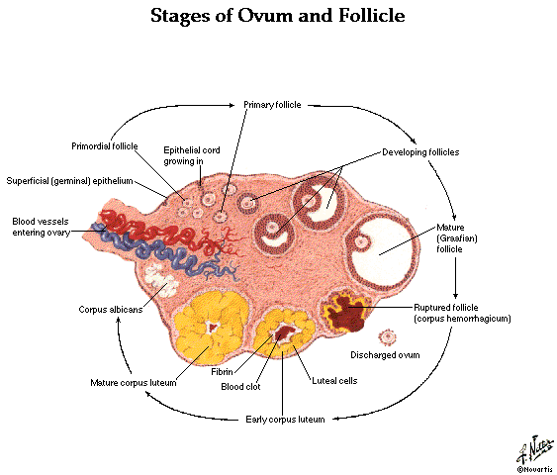
Difference between Oocyte & Follicle
An oocyte (egg)
develops in
the follicle
in the ovary

Slide 14
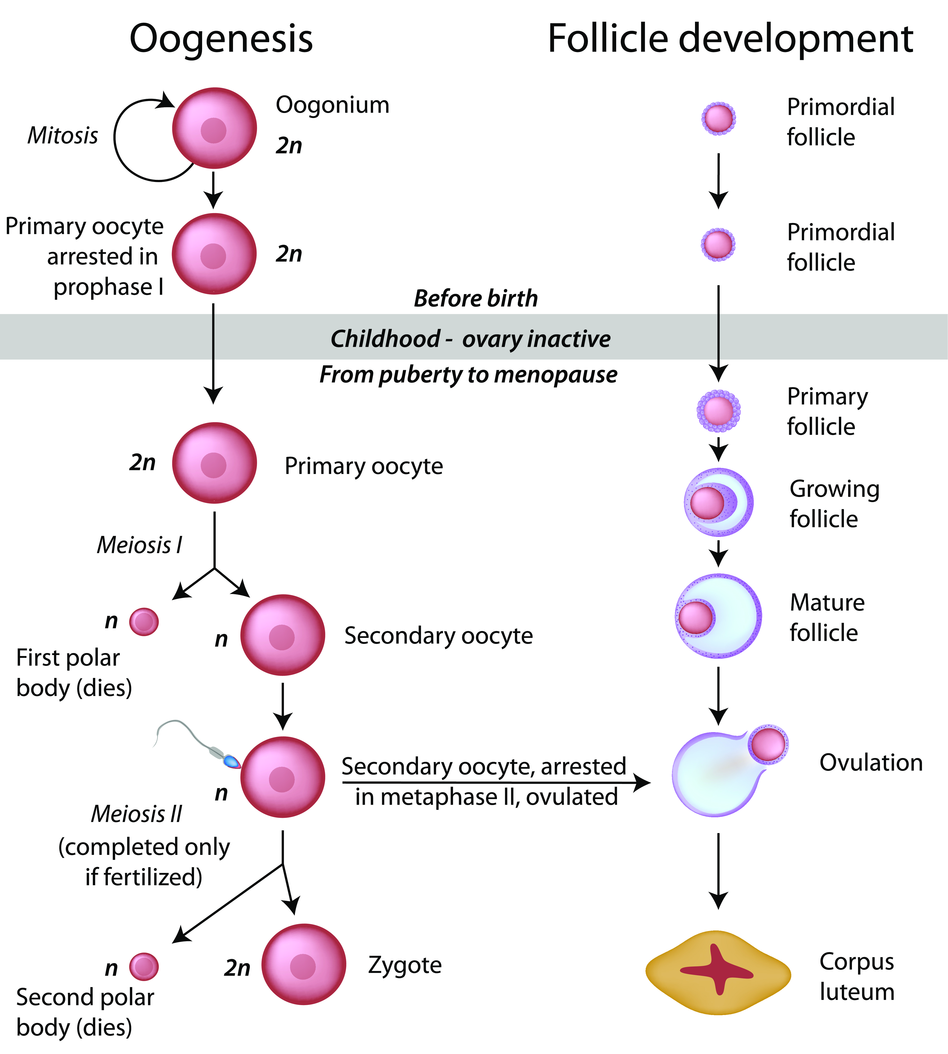
Fertilisation

Slide 15
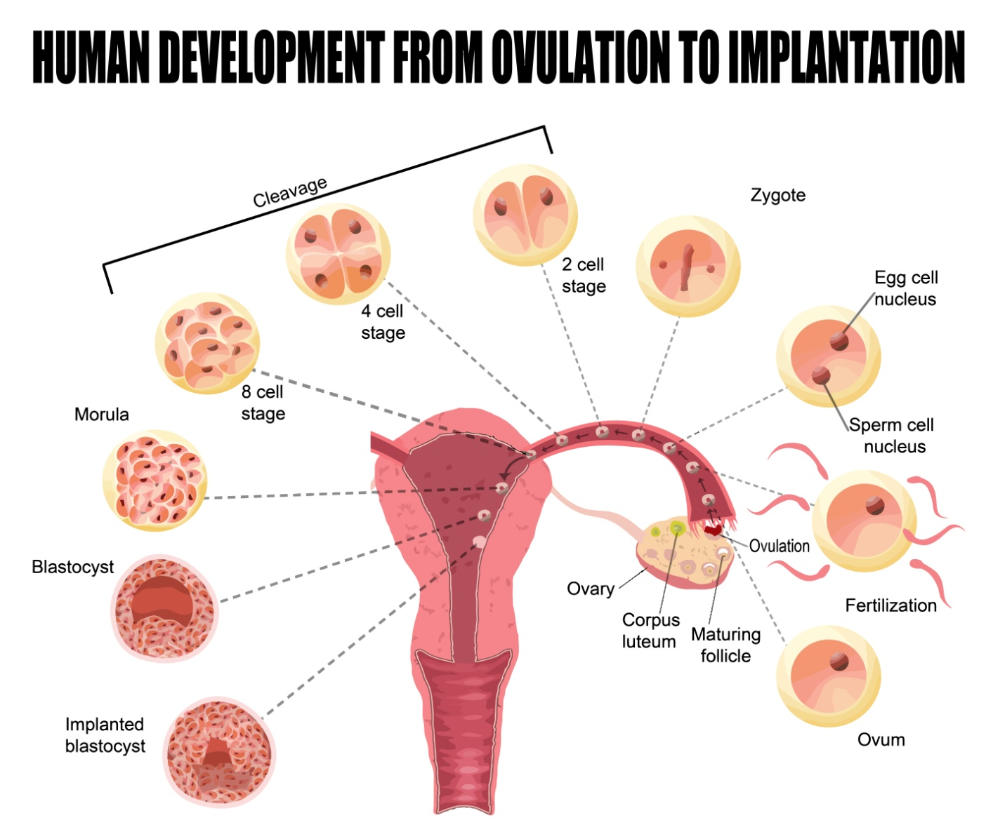
Fertilisation

Slide 16
Understanding Mucus

Slide 17
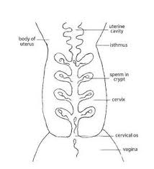
Role of the Cervix
The Cervix produces the mucus in crypts, therefore important not to damage the cervix – too long on the contraceptive pill can damage the cervix and may take several years to repair

Slide 18
Mucus & Hormones
Presence or absence of mucus,
and the varying types are a direct reflection of hormonal changes. Charting the variations is vital for providing an overview of hormone patterns.

Slide 19
Mucus & Hormones
Mucus that has changing characteristics indicates the
approach of ovulation.
Absence of mucus or non changing pattern of mucus indicates infertility

Slide 20
Mucus & Sperm
Sperm cells depend on
Fertile mucus (S mucus) for their survival and their ability to reach and fertilise the egg.
This presents as wet & slippery
with an egg white appearance

Slide 21
G Mucus
Gatekeeper
Forms a plug at the cervix at end of menstruation until the beginning of fertile phase and again after ovulation until menstruation. Closes up the cervix preventing sperm from entering, has antibiotic properties, protecting from infection.

Slide 22
G Mucus
Dry sensation
Nothing seen or felt

Slide 23
L Mucus
Eliminator
Attracts and eliminates low quality sperm
Creamy, sticky, pasty, crumbly.
White/cream colour

Slide 24
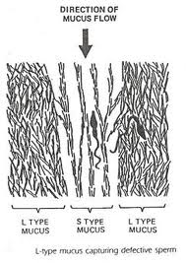
L Mucus

Slide 25
S Mucus
Fertile
Has vertical channels which assists the sperm to swim up the vaginal canal towards the ovum. Nourishes and protects the sperm for 3-5 days.
Feel damper increasing to wet
Start to see clearer appearance

Slide 26
S Mucus

Slide 27
P Mucus
Lubrication & Elimination
1st released with L mucus to dislodge the G mucus plug
2nd released with S mucus to make the slipper and wet sensation. Also eliminates the low quality sperm
Egg White Mucus when with S mucus

Slide 28
Order of Mucus during Cycle
G
L & S
P & L
P & S

Slide 29
Mucus Chart Symbols
Symbol | Description
• | Bleed
¨ | Spotting
I | Intercourse
| | Dry days – nothing felt or seen
O | Fertile Mucus – any other description (creamy, thick, sticky etc…)
X | Peak day – this is the last day of slippery sensation
1,2,3 | The 3 days after ovulation

Slide 30
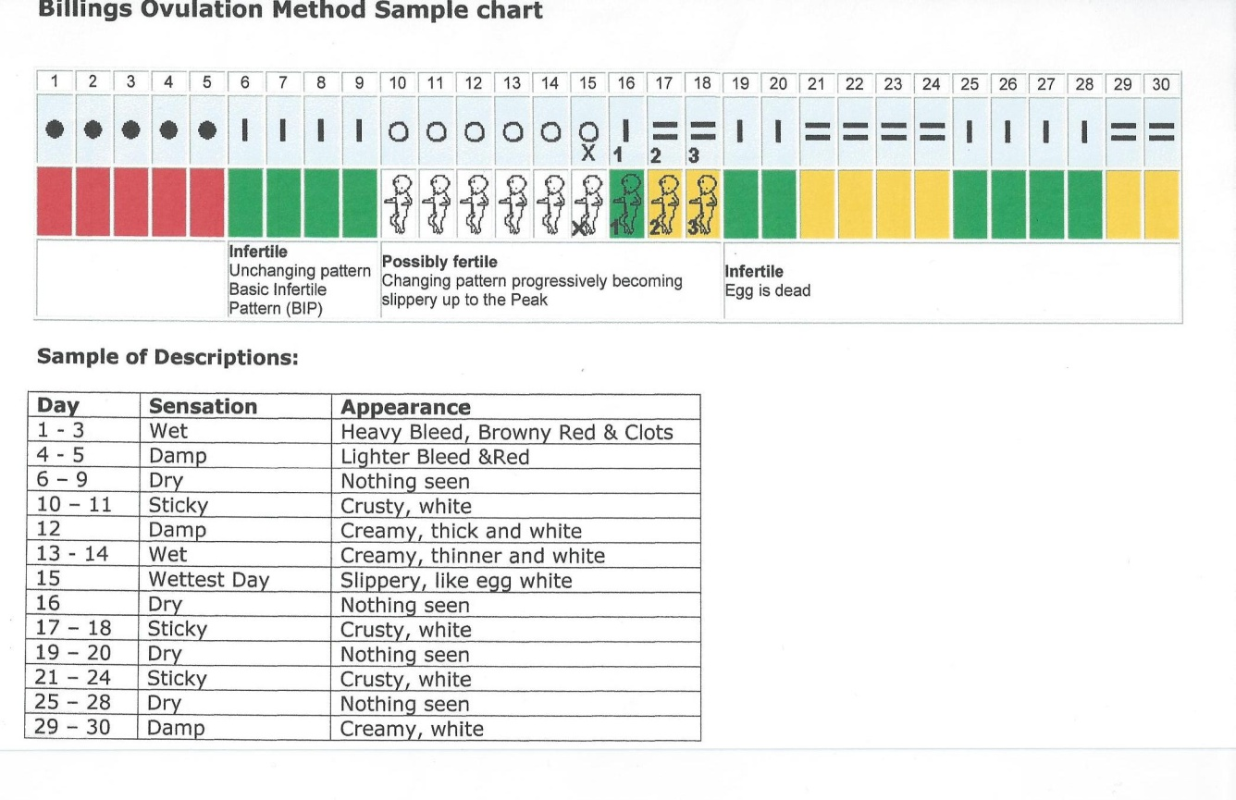
Sample of a Mucus Chart

Slide 31
Recognising Ovulation
Notes:
Group work to think of reasons why it benefits

Slide 32
3 Signs of Ovulation
Slippery wet mucus, after a progression of changing mucus from dry to damp & creamy, to wet and slippery. Last day of slippery sensation is PEAK
Swollen Vulva
Lymph node, pea sized node in inguinal lymph area on side that ovulating
Notes:
Group work to think of reasons why it benefits

Slide 33
Benefits of Charting
Notes:
Group work to think of reasons why it benefits

Slide 34
Benefits to Client
Optimises chance of conception
Bigger fertile window
More in tune with body’s rhythms
Notes:
Group work to think of reasons why it benefits

Slide 35
Benefits to Client
Will gain a true understanding of their cycle
Will be the first sign to knowing when they are pregnant.
It will also give them a clearer Estimated Due Date (EDD) as pregnancy lasts for 266 days +/- 6 days from the date of conception.
Knowing this information means that they are less likely to be induced, as often doctors/midwives base the EDD on cycle length, which may not be regular each month, therefore they could give you an EDD which is out by several days, forcing an induction.
Notes:
Group work to think of reasons why it benefits

Slide 36
Benefits to Everyone Else
Baby
Benefits by having the chance to enter the world when they are naturally ready.
Partner
Less structured love making schedule, with more opportunity he will feel less like sex is a chore!
Therapist
Gives a clear guide as to what is happening with clients’ cycles hormonally
Notes:
Group work to think of reasons why it benefits

Slide 37
Different Scenarios
Dry thought the month, no Fertile Mucus
no Ovulation &/or no bleed
FSH is below the threshold to initiate follicles in the ovary
No rise in LH therefore no Progesterone
Notes:
Group work to think of reasons why it benefits

Slide 38
Different Scenarios
Anovular bleeding – no ovulation
FSH rises above threshold but not enough to stimulate ovulation
No LH – therefore no ovulation
No progesterone
No peak
Bleeds – but these are not true menses
Notes:
Group work to think of reasons why it benefits

Slide 39
Different Bleeds
Withdrawal Bleed
When oestrogen levels drop it doesn’t support the endometrium and therefore bleeds.
Implantation Bleed
From after the 6th day of conception, implantation of the embryo into the endometrium may cause spotting
Notes:
Group work to think of reasons why it benefits

Slide 40
Different Bleeds
Intermenstrual Bleeding
Can occur due to an oestrogen rise which causes endometrial growth but no ovulation
Breakthrough Bleed
When oestrogen is high, bleeding occurs due to leaking from the endometrium
Notes:
Group work to think of reasons why it benefits

