Slide 1
A&P
Clare Blake N.D.
Fertility Massage Therapy & Training

Slide 2
What’s in our Abdomen?

Slide 3
What’s in our Abdomen?

Slide 4
What’s in our Abdomen?

Slide 5
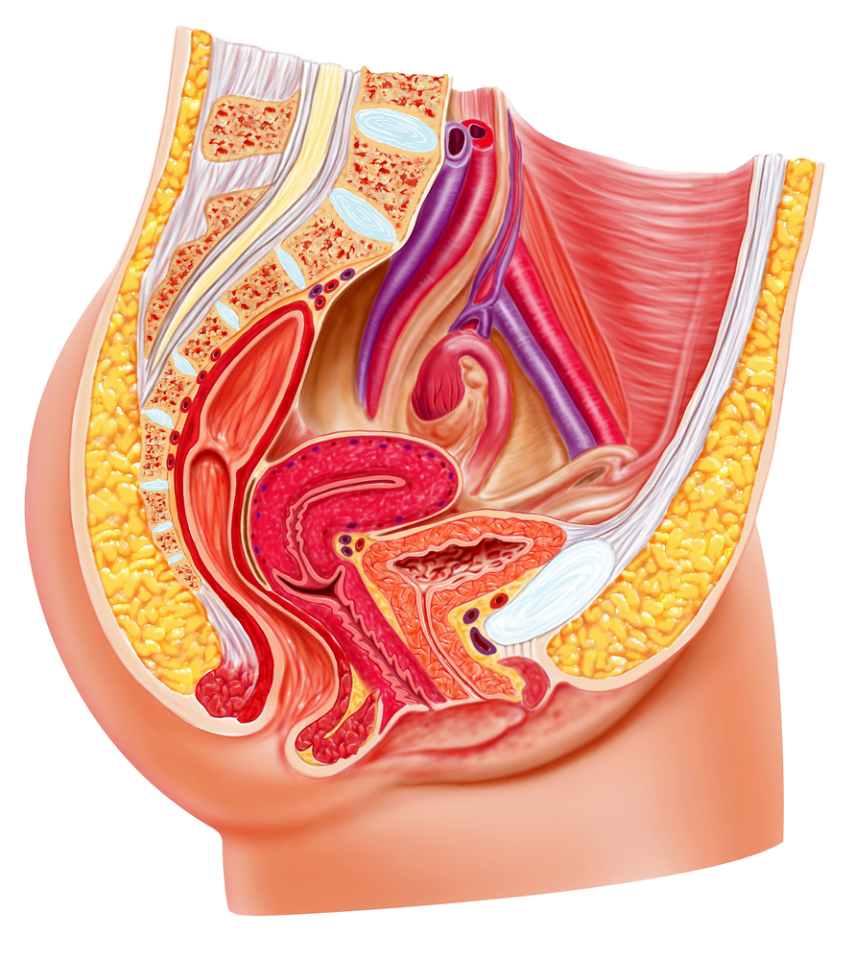
What’s in our Abdomen?

Slide 6
Womb
The Womb (Uterus) – Fundus (head), Body, Cervix (neck) and Os (opening to cervix)
Is 3" (7.5cm) long x 2" (5cm) wide x 1" thick.
Weighs from 1-2oz (non-menstruating)
2-4 oz (menstruating)
8-1lb (menstruating with pathology)
Approx 20lbs (pregnant)

Slide 7
Ligaments
Broad ligaments – flat & wide completely surrounding the uterus front & back
Round ligaments - 4-5in round cords. Attached to the sides of the uterus, extending toward and thru the inguinal canal, finally attaching into the perineal fascia
Cardinal ligament (Mackenrodt’s) – attached from the side of the cervix to the side of the pelvic wall. Supports both uterus and vagina and contains most of the uterine blood vessels
Uterosacral ligaments – from the 2/3 sacral bones to the side of the uterus.

Slide 8
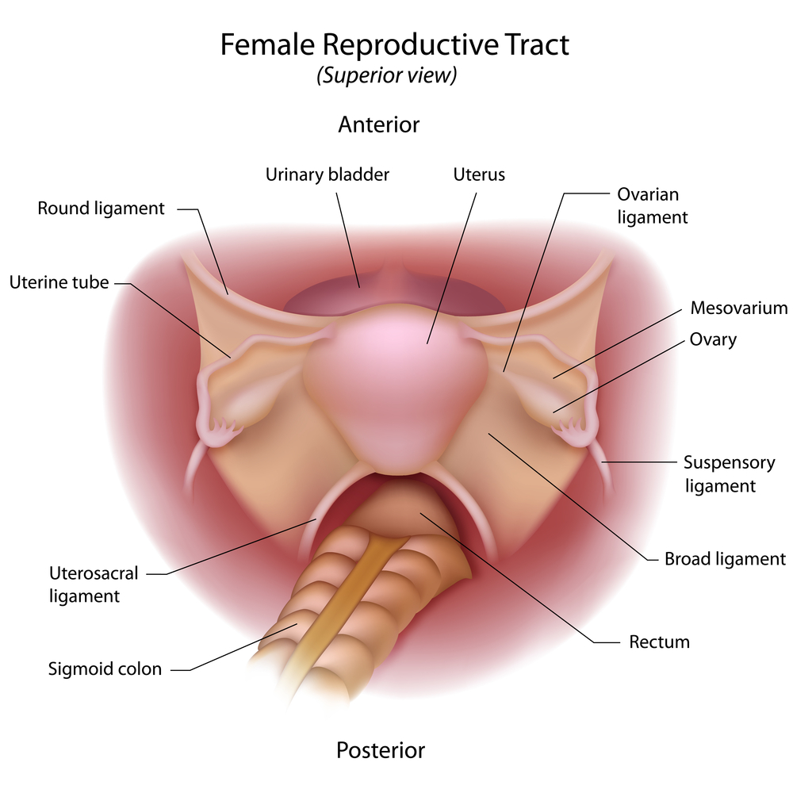
Reproductive Organs

Slide 9
Womb Positions

Slide 10
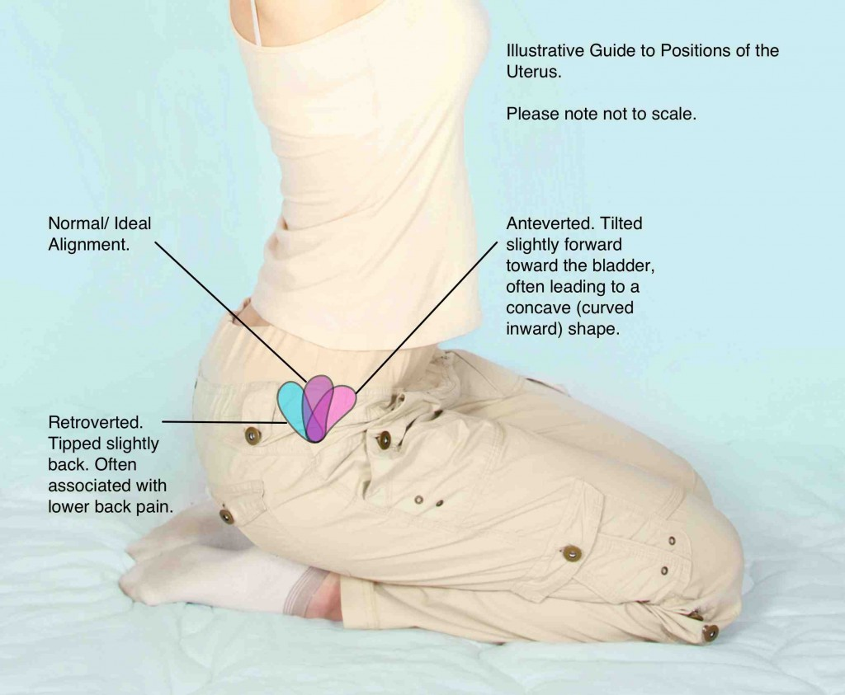
Womb Positions
Anatomical Term | Definition
Anteverted | Tipped Forwards
Anteflexed | Pointing Forwards
Retroverted | Tipped Backwards
Retroflexed | Pointing Backwards

Slide 11
Blood & Nerve Supply
Womb only receives 5% blood flow
Supplied by arterial blood both from the uterine artery and the ovarian artery.
Nerve supply
Sensory Nerves that supply the womb are from T11 and T12.
Parasympathetic supply is from second, third and fourth sacral nerves

Slide 12
Ovaries
We have 2 ovaries the shape of an almond
Approx 3-5cms (depending on age/pathologies)
Normally, they sit just below the Fallopian tubes
Key roles
to produce a mature egg for fertilisation
To produce Oestrogen & Progesterone

Slide 13
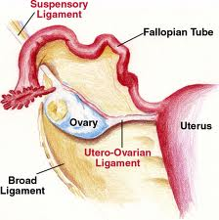
Ovaries
The ovaries are held in place by 2 ligaments:
Suspensory ligament – attached
from the fallopian tubes to the back
of the pelvis.
Ovarian (Proper) ligament –
attached from the mid part of the
vary to the side of the fundus

Slide 14
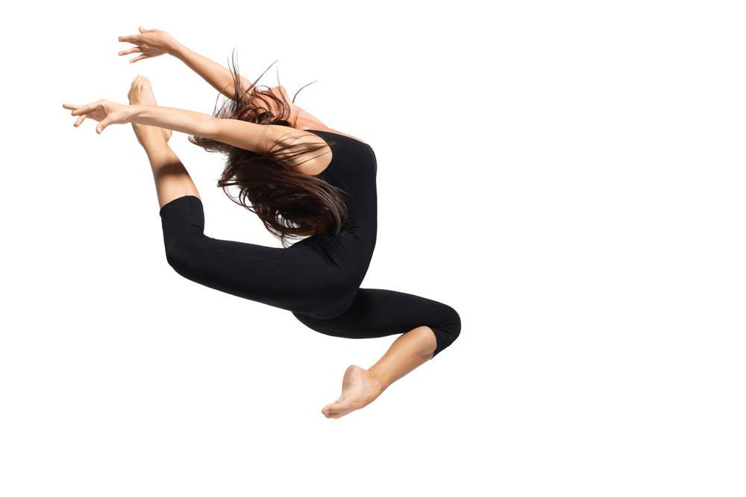
Fallopian Tubes
We have 2 fallopian tubes
Open ends, finger like – Fimbrae
Tubes lined with small hairs – Cilia
Fascinating Fact
They can Dance!

Slide 15
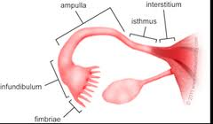
Fallopian Tubes
Key roles
Fimbrae beat back and forth to help guide the egg into the fallopian tube.
Cilia sweep the egg along
the fallopian tube
Fertilisation takes place in
the ampulla

Slide 16
Reproductive, Digestive & Sacrum
Why do we need to treat
all 3 for Fertility?

